Slide 1
CSE 465 Project Proposal
Name : Md. Mukith Al Alim
ID: 1711376042
Sec: 02

Slide 2
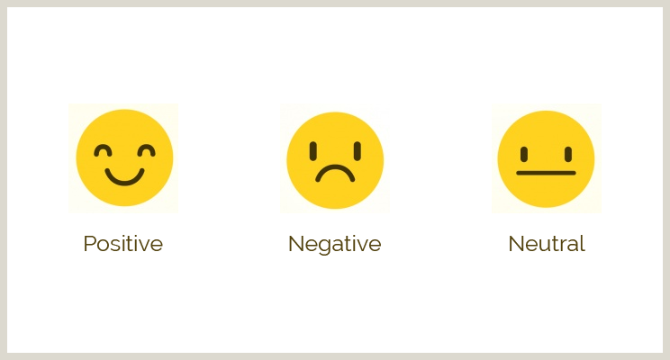
Predicting Movie Genre
Using BoW | CNN | LSTM
Sentiment Analysis is a predictive modelling task where the model is trained to predict the polarity of textual data or sentiments like Positive, Neutral, and negative.
Nowadays user saw any particular movies by seeing their reviews only.
Analyzing user’s sentiment is an important way for companies to be aware of their products and services being perceived.

Slide 3
Algorithms
BoW (Bag of Words)
CNN (Convolution Neural Network)
LSTM (Long Short Term Memory)– For Natural Language Processing
Dataset
We will use the Wikipedia Movie Plots dataset from Kaggle.
The dataset contains descriptions of 34,886 movies from around the world. Column descriptions are listed below:
Release Year - Year in which the movie was released
Title - Movie title
Origin/Ethnicity - Origin of movie (i.e. American, Bollywood, Tamil, etc.)
Director - Director(s)
Plot - Main actor and actresses
Genre - Movie Genre(s)
Wiki Page - URL of the Wikipedia page from which the plot description was scraped
Plot - Long form description of movie plot

Slide 4

Expected Result
It will Classification movie genre based on plot description .
The trained data will predict the polarity of textual data or sentiments like Positive, Neural, and negative.
It will analyze the sentiment of the movie reviews in the Wikipedia Movie dataset.

